Slide 1


Computer
Fundamentals
Dr. Safdar Nawaz Khan
Marwat
DCSE, UET
Peshawar
Lecture 6
safdar@uetpeshawar.edu.pk

Slide 2
Binary Logic Operations
➢ Also called Boolean logic operations
➢ Boolean variable can have only two possible values i.e.
0
or
1
➢ Logic operations or functions
of
Boolean
variables
❑ E.g.
AND,
OR,
NOT
etc.
safdar@uetpeshawar.edu.pk
2

Slide 3
Binary
Logic
Operations
Name
Example
Symbolically
Buffer
y = x
x
NOT
y = NOT(x)
x
AND
z = x AND y
x. y
OR
z = x OR y
x + y
XOR
z = x XOR y
x ⊕ y
NAND
z = x NAND y
x.y
NOR
z = x NOR y
x + y
XNOR
z = x XNOR y
x ⊕ y
safdar@uetpeshawar.edu.pk
3

Slide 4
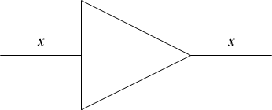
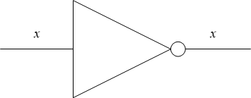
Diagrammatic
Representation
➢ Buffer
➢ NOT
safdar@uetpeshawar.edu.pk
4

Slide 5
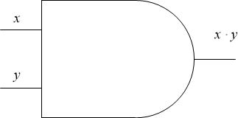
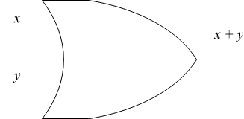
Diagrammatic
Representation
(cont.)
➢ AND
➢ OR
safdar@uetpeshawar.edu.pk
5

Slide 6
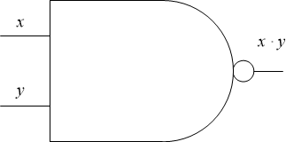
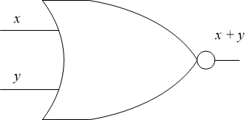
Diagrammatic
Representation
(cont.)
➢ NAND
➢ NOR
safdar@uetpeshawar.edu.pk
6

Slide 7
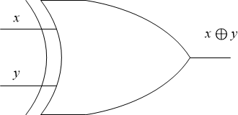
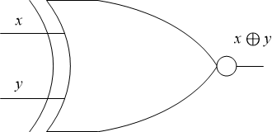
Diagrammatic
Representation
(cont.)
➢ XOR
➢ XNOR
safdar@uetpeshawar.edu.pk
7

Slide 8
Boolean Laws
➢ AND
0 ⋅
1⋅
x
x
= 0
= x
➢ OR
0 +
1+
x
x
= x
= 1
safdar@uetpeshawar.edu.pk
8

Slide 9
Boolean
Laws
(cont.)
➢ AND
x ⋅
x ⋅
x
=
=
x
0
x
➢ OR
x + x
=
=
x
1
x + x
safdar@uetpeshawar.edu.pk
9

Slide 10
Boolean Laws
(cont.)
➢ AND
❑ Commutativity
x ⋅ y =
y
⋅ x
❑ Associativity
(x ⋅ y )⋅
=
x ⋅ (y ⋅ z )
z
❑ Distributivity
x ⋅ (y
+ z )
= (x ⋅ y ) +
(x
⋅ z )
safdar@uetpeshawar.edu.pk
10

Slide 11
Boolean Laws
(cont.)
➢ OR
❑ Commutativity
x + y = y
❑ Associativity
+ x
(x + y ) +
❑ Distributivity
z = x +
(y +
z )
x + (y
⋅ z )
= (x +
y )⋅ (x
+
z )
safdar@uetpeshawar.edu.pk
11

Slide 12
Boolean Laws
(cont.)
➢ DeMorgan’s
Law
❑ NAND
x ⋅ y =
x +
y
❑ NOR
x +
y =
x ⋅
y
safdar@uetpeshawar.edu.pk
12

Slide 13
Truth Table
➢ Defines the output of
a logic function for all
possible
inputs
❑
2^{n}
rows in a truth table
(n
is
the
number
of
inputs)
➢ Truth
table
for
NOT
x
x
0
1
1
0
safdar@uetpeshawar.edu.pk
13

Slide 14
Truth Table
(cont.)
➢ Truth
table
for
OR
x
y
x + y
0
0
0
1
1
0
1
1
safdar@uetpeshawar.edu.pk
14

Slide 15
Truth Table (cont.)
➢ Truth
table
for
AND
x
y
x. y
0
0
0
1
1
0
1
1
safdar@uetpeshawar.edu.pk
15

Slide 16
Truth Table (cont.)
➢ Truth
table
for
XOR
x
y
x ⊕ y
0
0
0
1
1
0
1
1
safdar@uetpeshawar.edu.pk
16

Slide 17
Truth Table (cont.)
➢ Truth
table
for
NOR
x
y
x + y
x + y
0
0
0
1
1
0
1
1
safdar@uetpeshawar.edu.pk
17

Slide 18
Truth Table (cont.)
➢ Truth
table
for
NAND
x
y
x. y
x.y
0
0
0
1
1
0
1
1
safdar@uetpeshawar.edu.pk
18

Slide 19
Truth Table (cont.)
➢ Truth
table
for
XNOR
x
y
x ⊕ y
x ⊕ y
0
0
0
1
1
0
1
1
safdar@uetpeshawar.edu.pk
19

Slide 20
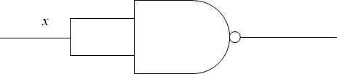
NAND for Every Gate
➢ Possible to emulate any gate
❑ Using combination of NAND
gates
➢ NOT gate with NAND
❑ Compare
with
NOT
x
x.x
x.x
0
0
1
1
1
0
safdar@uetpeshawar.edu.pk
20

Slide 21
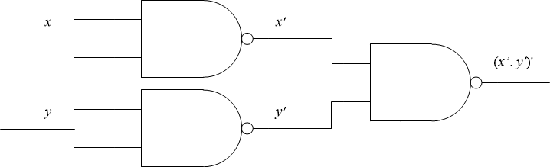
NAND for Every
Gate
(cont.)
➢ OR gate with NAND
❑ Recall DeMorgan’s
Law
x +
y =
x.y
safdar@uetpeshawar.edu.pk
21

Slide 22
NAND for Every
Gate
(cont.)
➢ OR gate with NAND
❑ Recall DeMorgan’s
Law
x + y = x.y
❑ Compare
with
OR
x
y
x.x = x
y. y = y
x.y
0
0
1
1
0
0
1
1
0
1
1
0
0
1
1
1
1
0
0
1
safdar@uetpeshawar.edu.pk
22

Slide 23
Exercise
➢ Design
AND
gate
using
only
NAND
gates
safdar@uetpeshawar.edu.pk
23

